Slide 1
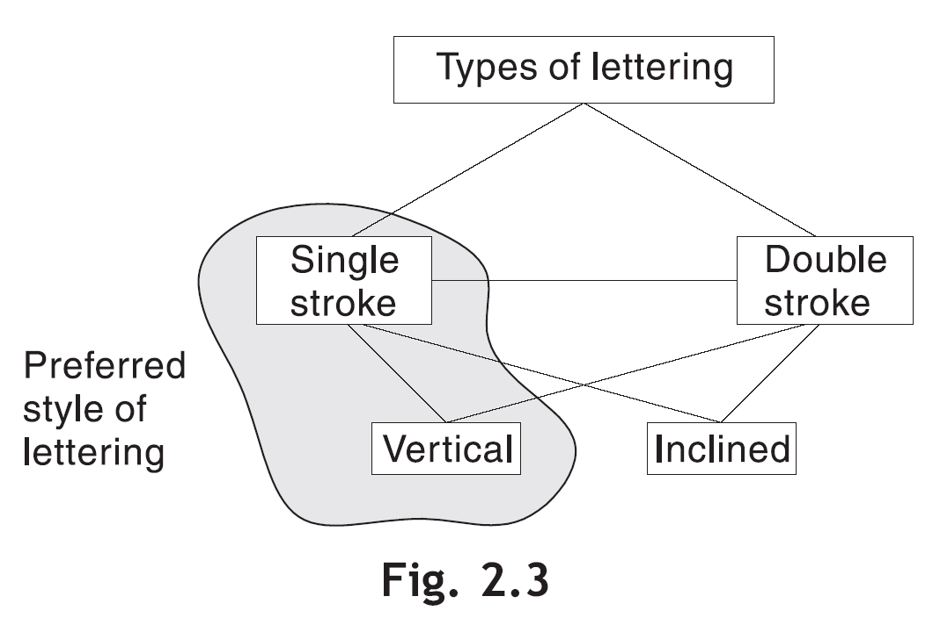
LETTERING
Lettering is an art of writing text on a drawing by using alphabets, numerals and symbols. Two types of lettering are commonly used—(1) single stroke, and (2) double stroke. Single stroke or double stroke letters may be vertical or inclined, Fig. 2.3. The line width of a double stroke letter is greater than that of a single stroke letter.

Slide 2
Lettering Rules
Draw letters as simple as possible. Artistic or cursive lettering should be strictly avoided.
They should appear upright from Bottom Edge, except when they are used for dimensioning.
Round-off the sharp corners wherever necessary, e.g., D, P, S, etc.
Distance between two letters in a word should be 2 mm.
The height of all the letters in one line should be the same.
Use single stroke vertical CAPITAL letters as much as possible.
Words should be spaced one letter width apart and distance between two lines is equal to height of one letter.
Letters and numerals are designated by their heights.

Slide 3
Different ratios used for Gothic Letters:-
7:5 is height to width ratio for all Alphabets except i,j,l,m,w.
7:4 is height to width ratio for all Numerals except 1.
7:1 is the height to thickness ratio of the LINE used for writing letters.
7:1 is for i.
7:3 is for 1
7:4 is for L & j.
7:6 is for M.
7:8 is for W.

Slide 4
Styles of Lettering
Lettering should be simple, legible and uniform. One such style, most popular among engineers, is called the Gothic style of lettering. Gothic lettering has a uniform line width for all the parts of a letter.
Single Stroke Vertical Gothic Lettering
This is the most common and preferred lettering style. ‘Single stroke’ refers to the thickness obtained in one stroke of a pencil or ink pen. It does not mean that the pencil or pen should not be lifted while completing a particular letter. The letters are drawn upright.
Figure 2.6 shows the alphabets, numerals, symbols and punctuation marks drawn in single stroke vertical gothic style (height = 7 mm, line width = 0.5 mm). The width of various charactersmay be noted carefully. Figure 2.7 shows a sample lettering using this style.

Slide 5
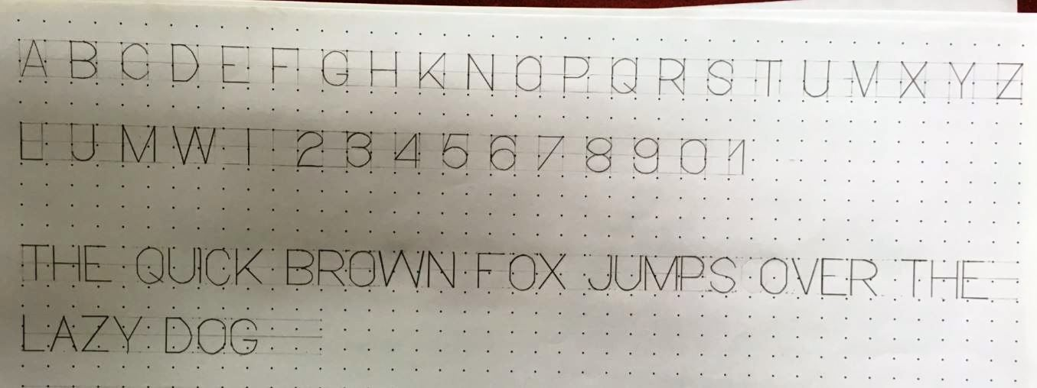

Slide 6
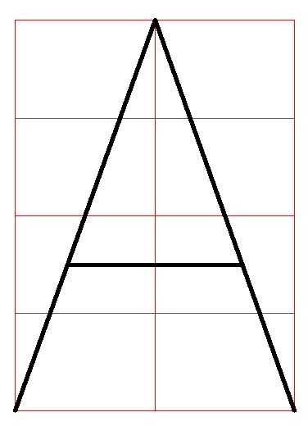

Slide 7
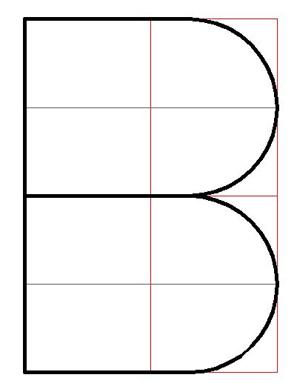

Slide 8
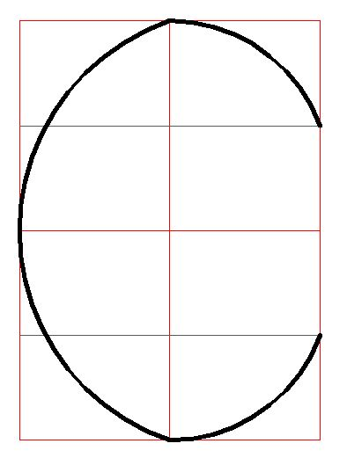

Slide 9
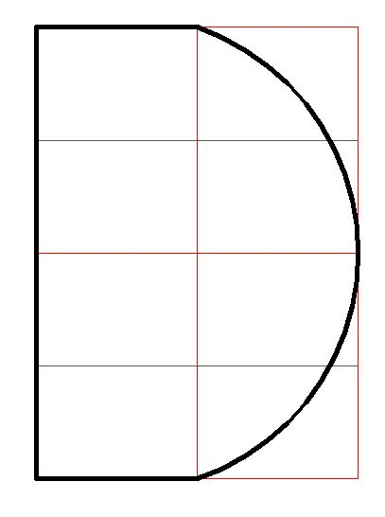

Slide 10
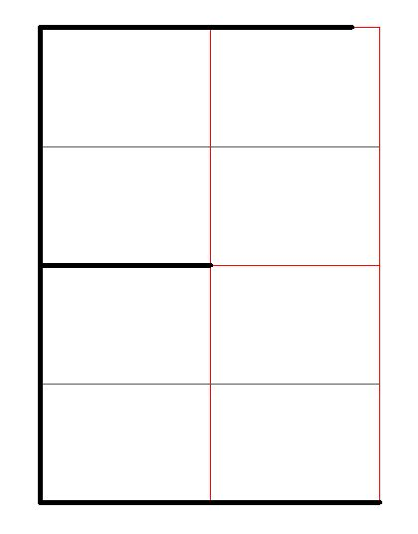

Slide 11
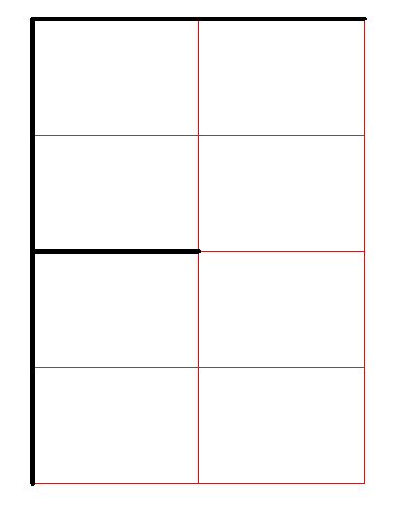

Slide 12
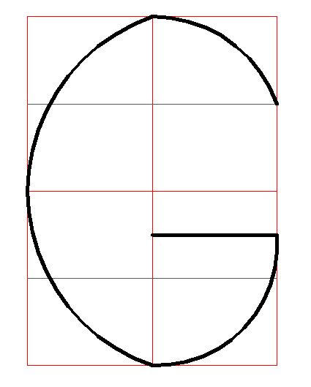

Slide 13
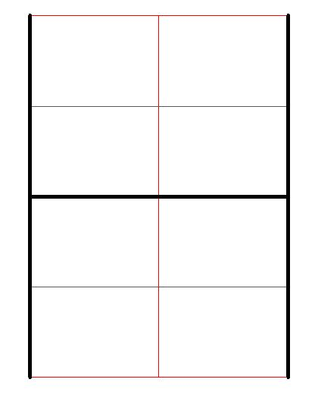

Slide 14
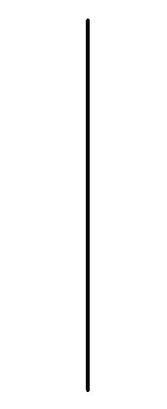

Slide 15
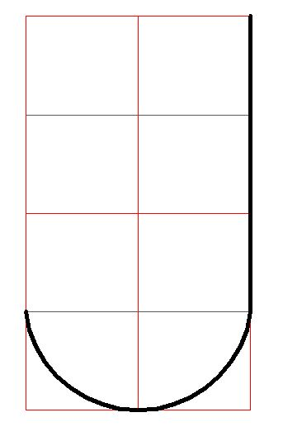

Slide 16
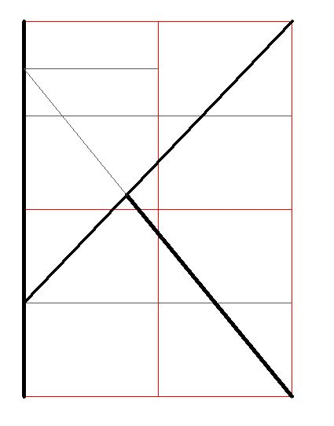

Slide 17
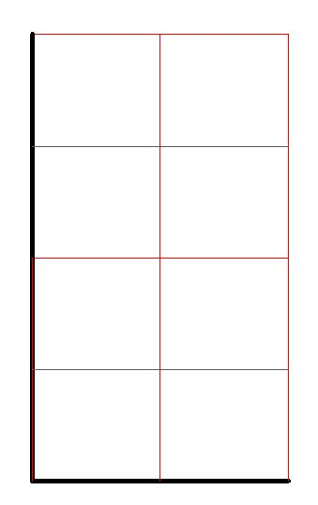

Slide 18
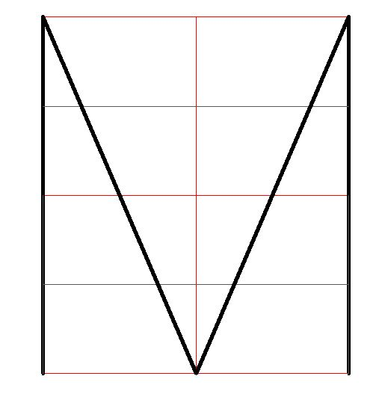

Slide 19
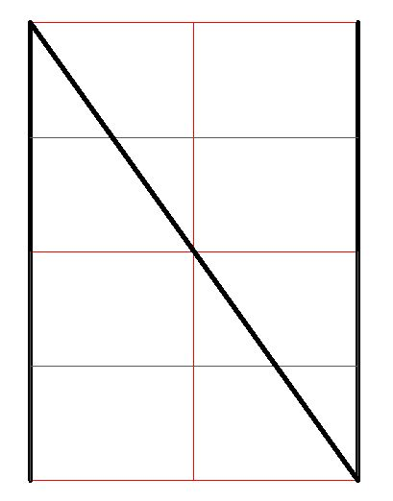

Slide 20
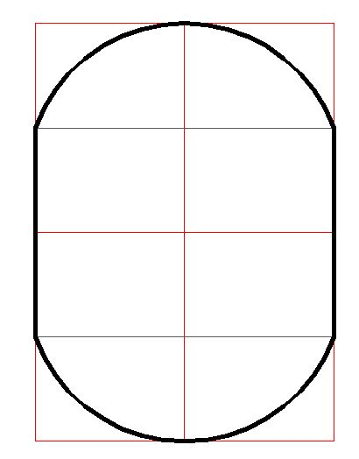

Slide 21
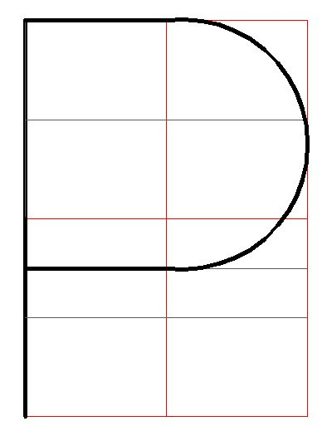

Slide 22
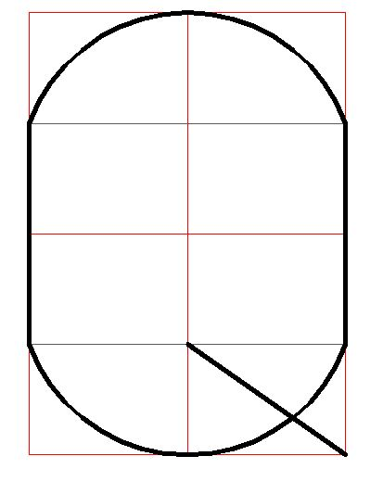

Slide 23
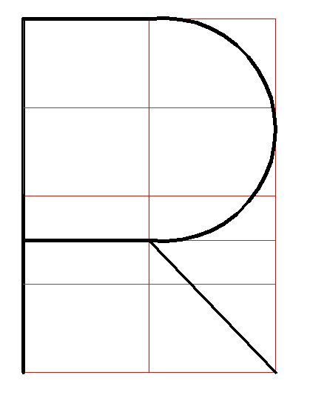

Slide 24
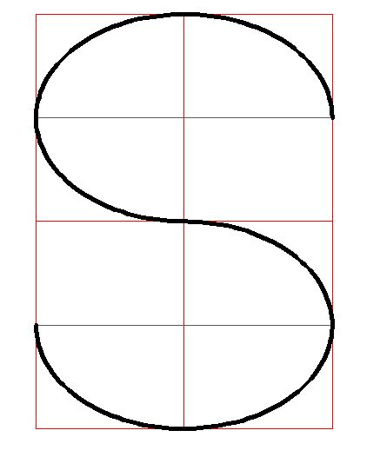

Slide 25
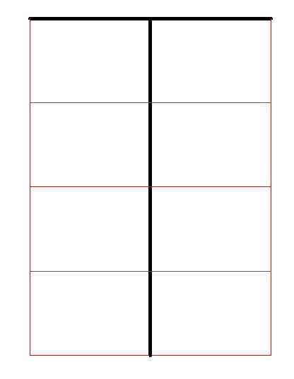

Slide 26
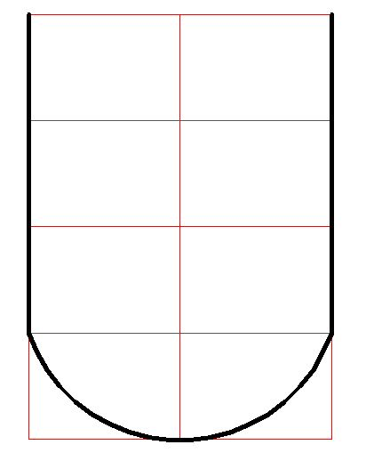

Slide 27
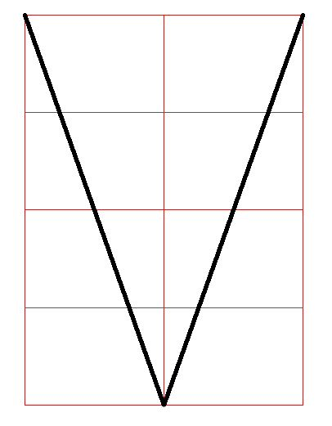

Slide 28
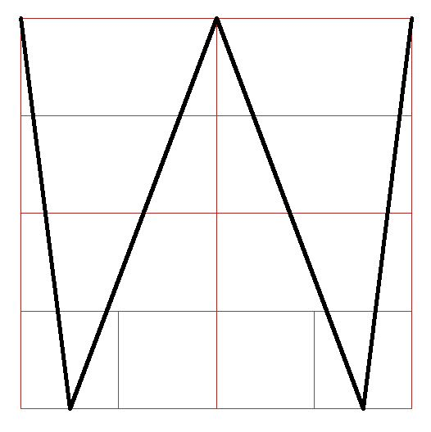

Slide 29
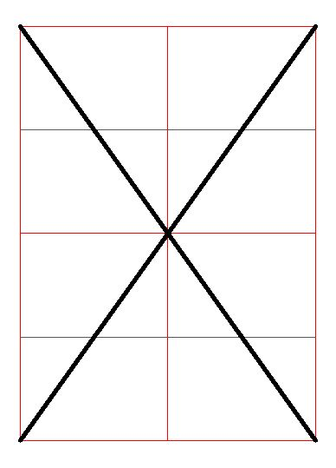

Slide 30
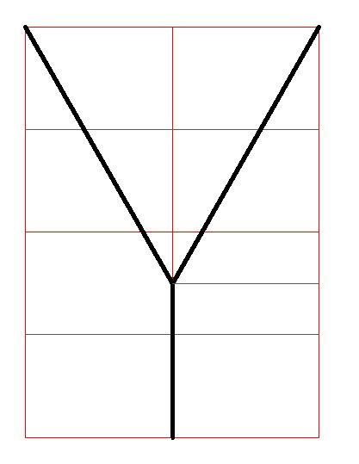

Slide 31
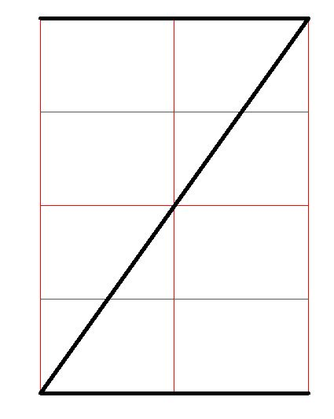

Slide 32
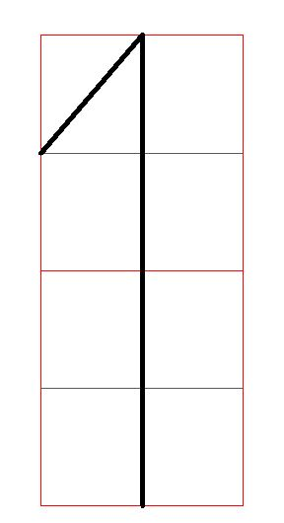

Slide 33
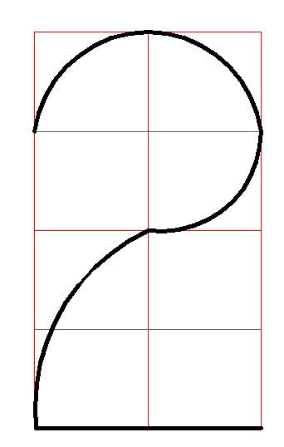

Slide 34
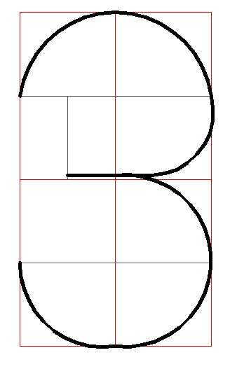

Slide 35
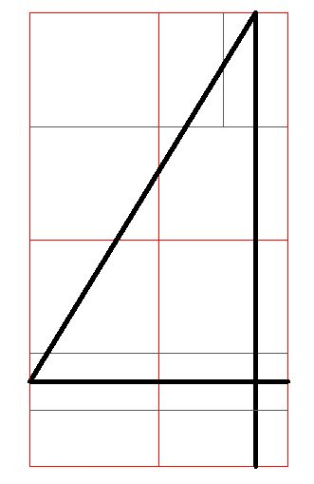

Slide 36
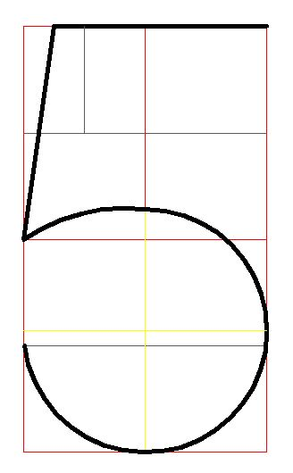

Slide 37
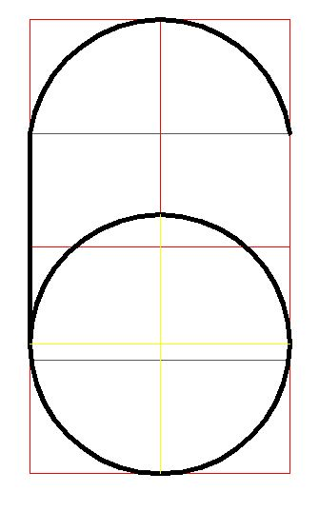

Slide 38
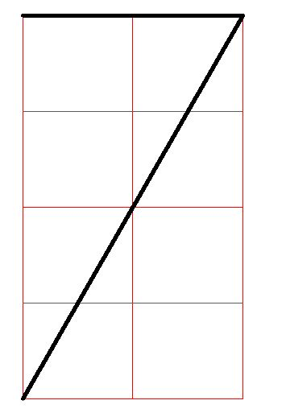

Slide 39
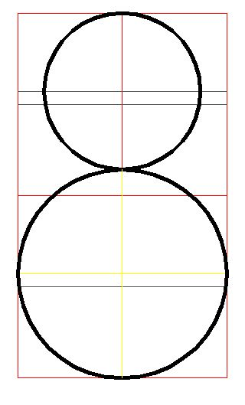

Slide 40
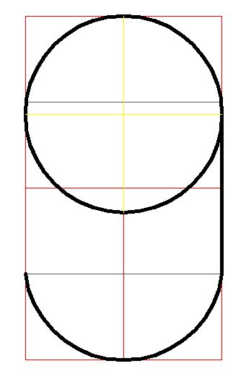

Slide 41
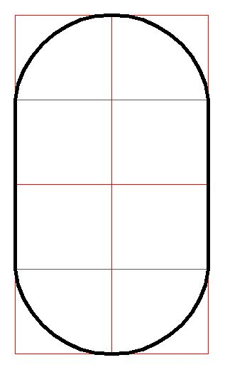

Slide 42
Q: Write the following sentence in Gothic Letters
“THE QUICK BROWN FOX JUMPS OVER THE LAZY DOG”
Take height of letter as 28 mm.

Slide 43
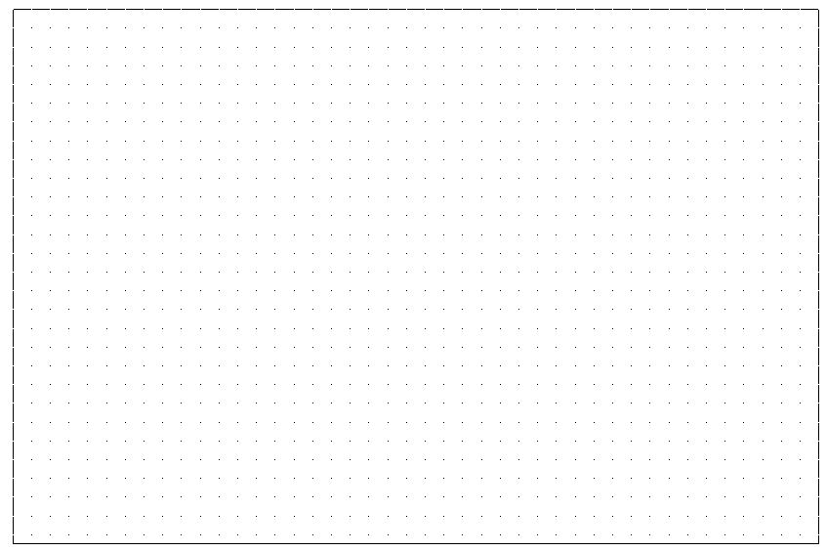

Slide 44
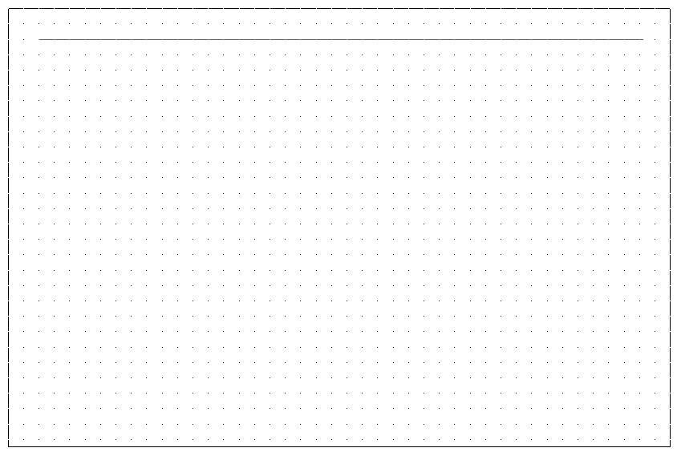

Slide 45
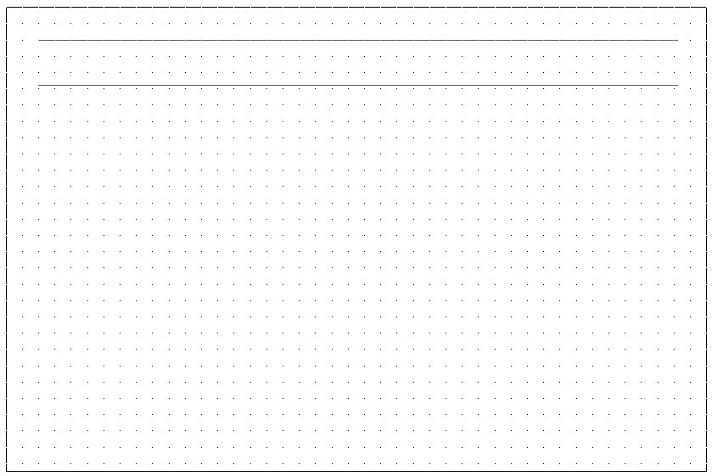

Slide 46
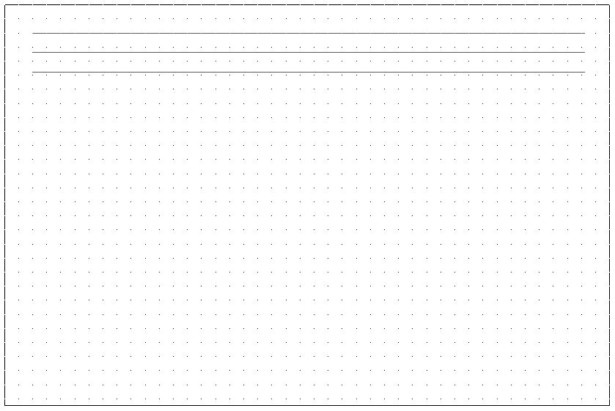

Slide 47
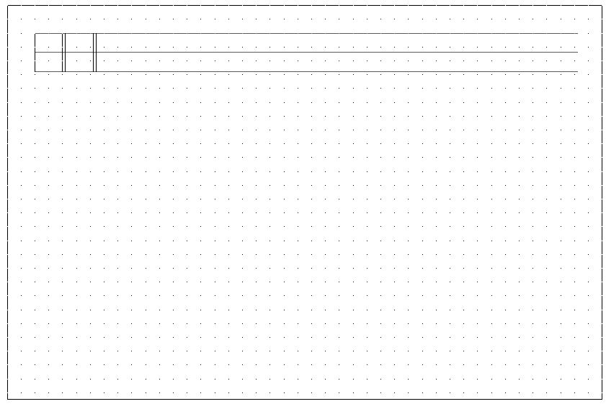

Slide 48
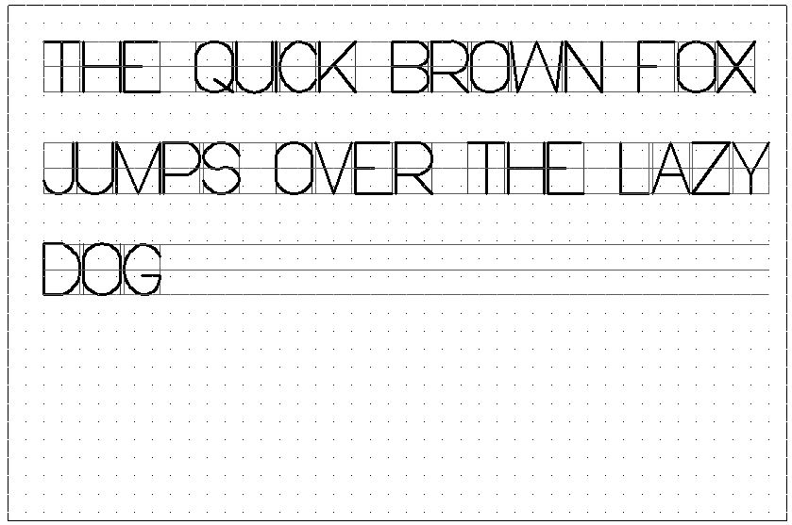
i = 7:1
J & L = 7:4
M = 7:6
W = 7:8

